Slide 1
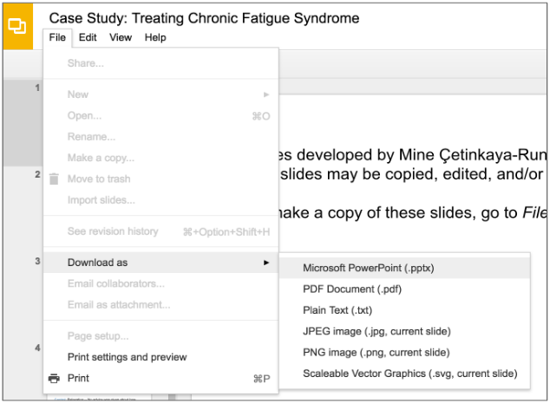
Slides developed by Mine Çetinkaya-Rundel of OpenIntro.
Translated from LaTeX to Google Slides by Curry Hilton of OpenIntro.
The slides may be copied, edited, and/or shared via the CC BY-SA license.
To make a copy of these slides, go to File > Download as > [option], as shown below. Or if you are logged into a Google account, you can choose Make a copy... to create your own version in Google Drive.

Slide 2
Considering
Categorical Data

Slide 3
Contingency Tables
A table that summarizes data for two categorical variables is called a contingency table.

Slide 4
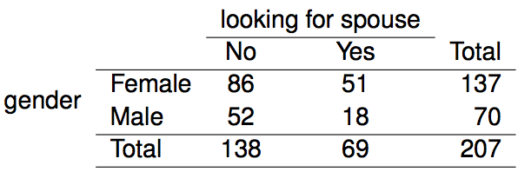
Contingency Tables
A table that summarizes data for two categorical variables is called a contingency table.
The contingency table below shows the distribution of students' genders and whether or not they are looking for a spouse while in college.

Slide 5
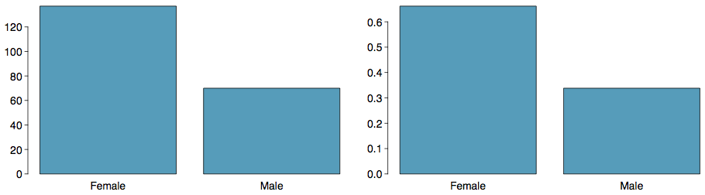
Bar Plots
A bar plot is a common way to display a single categorical variable. A bar plot where proportions instead of frequencies are shown is called a relative frequency bar plot.

Slide 6
Bar Plots
A bar plot is a common way to display a single categorical variable. A bar plot where proportions instead of frequencies are shown is called a relative frequency bar plot.
How are bar plots different than histograms?

Slide 7
Bar Plots
A bar plot is a common way to display a single categorical variable. A bar plot where proportions instead of frequencies are shown is called a relative frequency bar plot.
How are bar plots different than histograms?
Bar plots are used for displaying distributions of categorical variables, while histograms are used for numerical variables. The x-axis in a histogram is a number line, hence the order of the bars cannot be changed, while in a bar plot the categories can be listed in any order (though some orderings make more sense than others, especially for ordinal variables.)

Slide 8
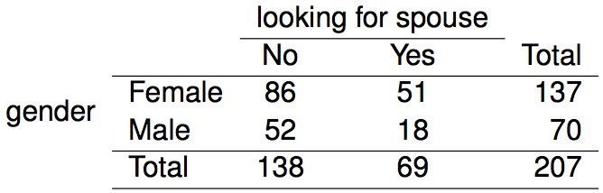
Choosing the
Appropriate Proportion
Does there appear to be a relationship between gender and whether the student is looking for a spouse in college?

Slide 9
Choosing the
Appropriate Proportion
Does there appear to be a relationship between gender and whether the student is looking for a spouse in college?
To answer this question we examine the row proportions:

Slide 10
Choosing the
Appropriate Proportion
Does there appear to be a relationship between gender and whether the student is looking for a spouse in college?
To answer this question we examine the row proportions:
% Females looking for a spouse: 51 / 137 ~ 0.37

Slide 11
Choosing the
Appropriate Proportion
Does there appear to be a relationship between gender and whether the student is looking for a spouse in college?
To answer this question we examine the row proportions:
% Females looking for a spouse: 51 / 137 ~ 0.37
% Males looking for a spouse: 18 / 70 ~ 0.26

Slide 12
Bar plots with two variables
Stacked bar plot: Graphical display of contingency table information, for counts.
Side-by-side bar plot: Displays the same information by placing bars next to, instead of on top of, each other.
Standardized stacked bar plot: Graphical display of contingency table information, for proportions.

Slide 13
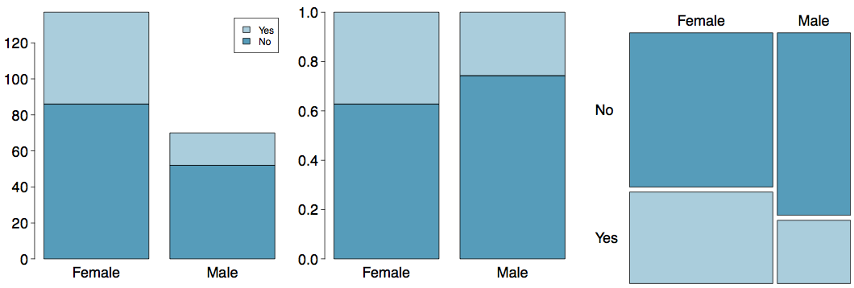
Segmented Bar and Mosaic Plots
What are the differences between the three visualizations shown below?

Slide 14
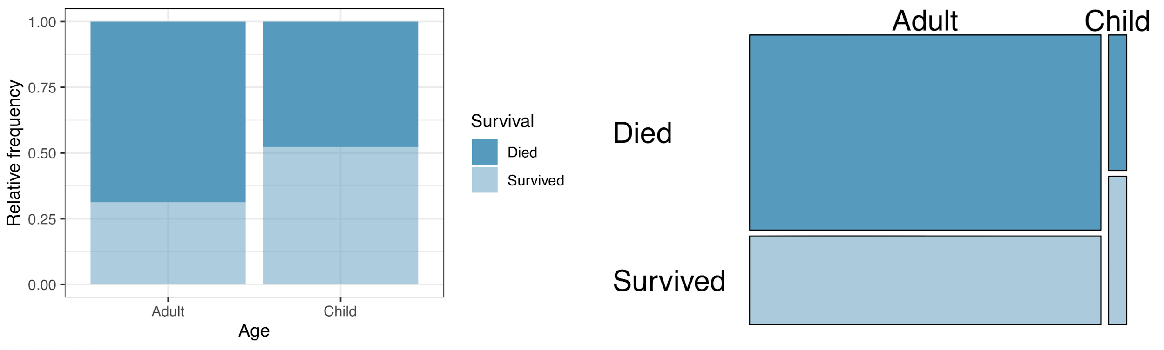
Mosaic plots
What are the differences between the two visualizations shown below?

Slide 15
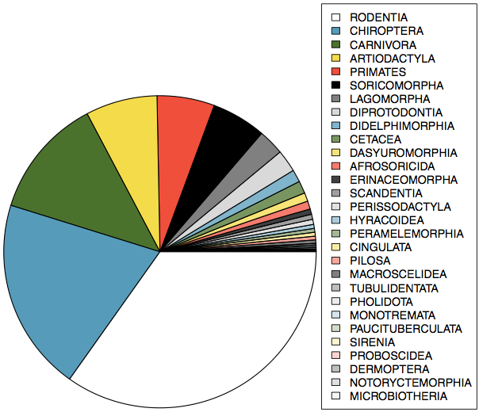
Pie Charts
Can you tell which order encompasses the lowest percentage of mammal species?
http://www.bucknell.edu/msw3

Slide 16
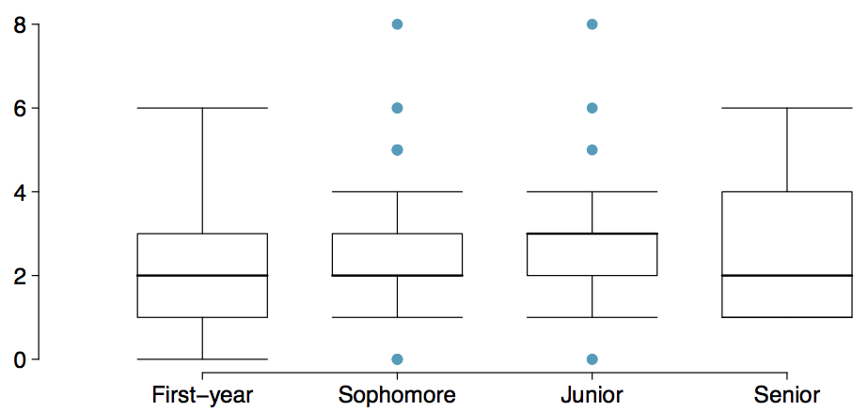
Comparing Numerical Data
Across Groups
Does there appear to be a relationship between class year and number of clubs students are in?

Slide 17
Find more resources at openintro.org/os, including
Slides
Videos
Statistical Software Labs
Discussion Forums (free support for students and teachers)
Learning Objectives
Teachers only content is also available for Verified Teachers, including
Exercise solutions
Sample exams
Ability to request a free desk copy for a course
Statistics Teachers email group
Questions? Contact us.

